Slide 1
CS 4530: Fundamentals of Software Engineering Module 4: Web Applications
Adeel Bhutta, Rob Simmons, and Mitch Wand
Khoury College of Computer Sciences
© 2026 Released under the CC BY-SA license

Slide 2
Learning Goals for this Lesson
At the end of this lesson, you should be able to
Explain the role of “client” and “server” in the context of web application programming
Explain the role of REST versus WebSocket communication
Describe the fundamental differences between the three layers of the controller, service, and repository layers in a C-S-R architecture
Be able to answer an interview question about “business logic,” “horizontal and vertical scaling,” or “microservices”

Slide 3






So, software engineering must encompass:
PEOPLE
PROCESSES
PROGRAMS
PLANNING
We’re gonna be stuck over here for a bit.
ORGANIZING
implementing
Notes:
So far in this class, every lecture has been about organizing people, processes, and programs in some way: when we talk about testing or typescript, we saw a lot of code but discussed how contracts and tests are communicating with the future (people) and how code coverage metrics lets us quantitively assess our progress (processes).
In the next few lectures, we’re going to be “stuck” over on the right a little bit, focusing more on some programming knowledge you’ll need as you move past IP1 to the other individual projects and the big group project.
Almost every class in software engineering needs to do this, because you can’t learn software engineering without doing some programming in the context of a large software project. The next few lectures are about how our particular variety of large software project works: a web application. What’s a web app?

Slide 4
Web Applications are Distributed Systems
Distributed systems are hard!
Web applications are designed to only be kinda difficult-to-build distributed systems
Most of this lecture is bad advice if you’re Google, Netflix, or Amazon
Web applications are distributed systems because
You don’t live in the cloud
Scalability: Netflix needs at least two computers
Notes:
A web application is a relatively simple and extremely common example of a distributed system.
This is necessary given the goals of our website, and most websites: GameNite wants to help people play a game if they’re not in the same place, so they’re distributed. Websites also need to be distributed for scalability, which we’ll talk about, but only a bit.

Slide 5
An Insultingly Shallow Intro to Networking
SERVER
(a program running on a computer in a data center somewhere)
CLIENT
(a web browser running in a consumer operating system on a consumer device)
internet
Notes:
This lecture is trying to cover material you could spend a semester learning in:
CS 3700 Networks and Distributed Systems
CS 4550 Web Development
CS 4730 Distributed Systems
CS 6650 Building Scalable Distributed Systems
Suffice to say this is an overview: a server (in a data center) is trying to communicate with a client (a web browser on your laptop) over the internet. How does that work?

Slide 6

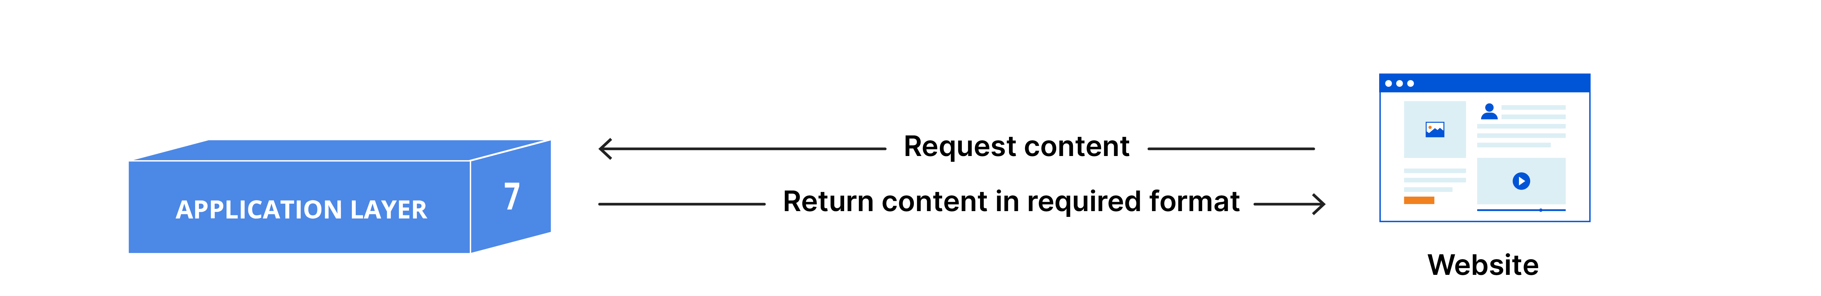
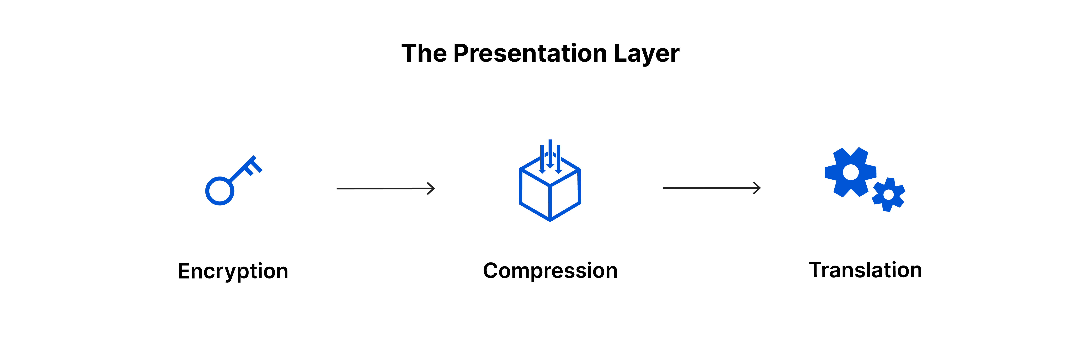
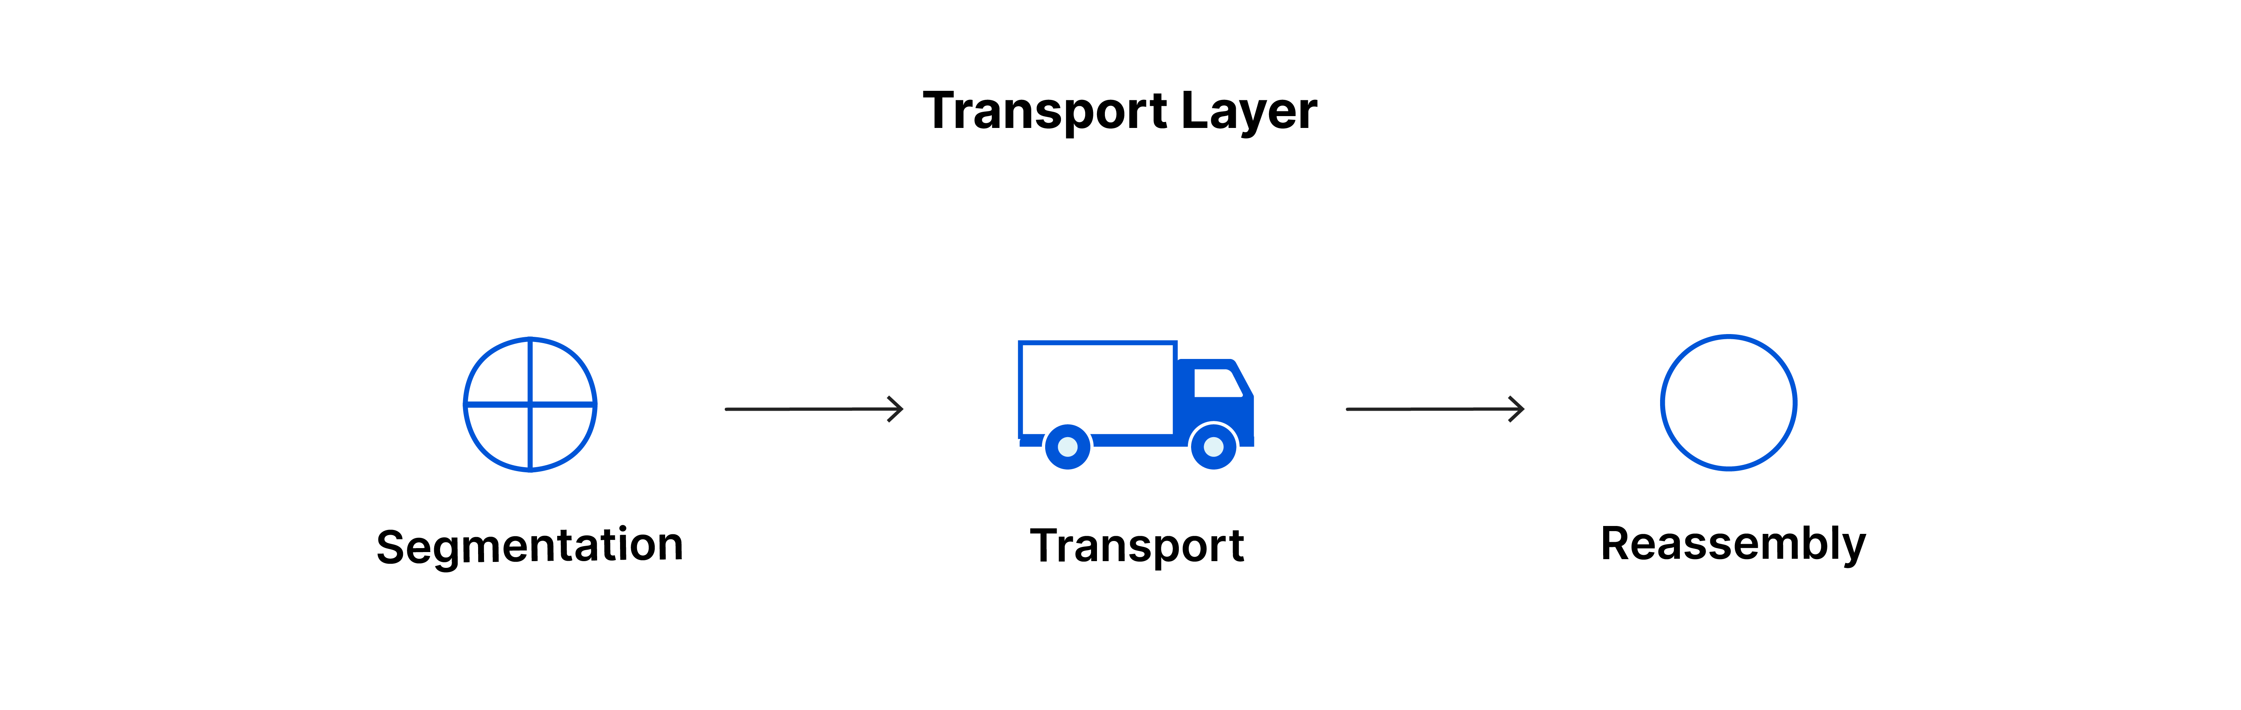
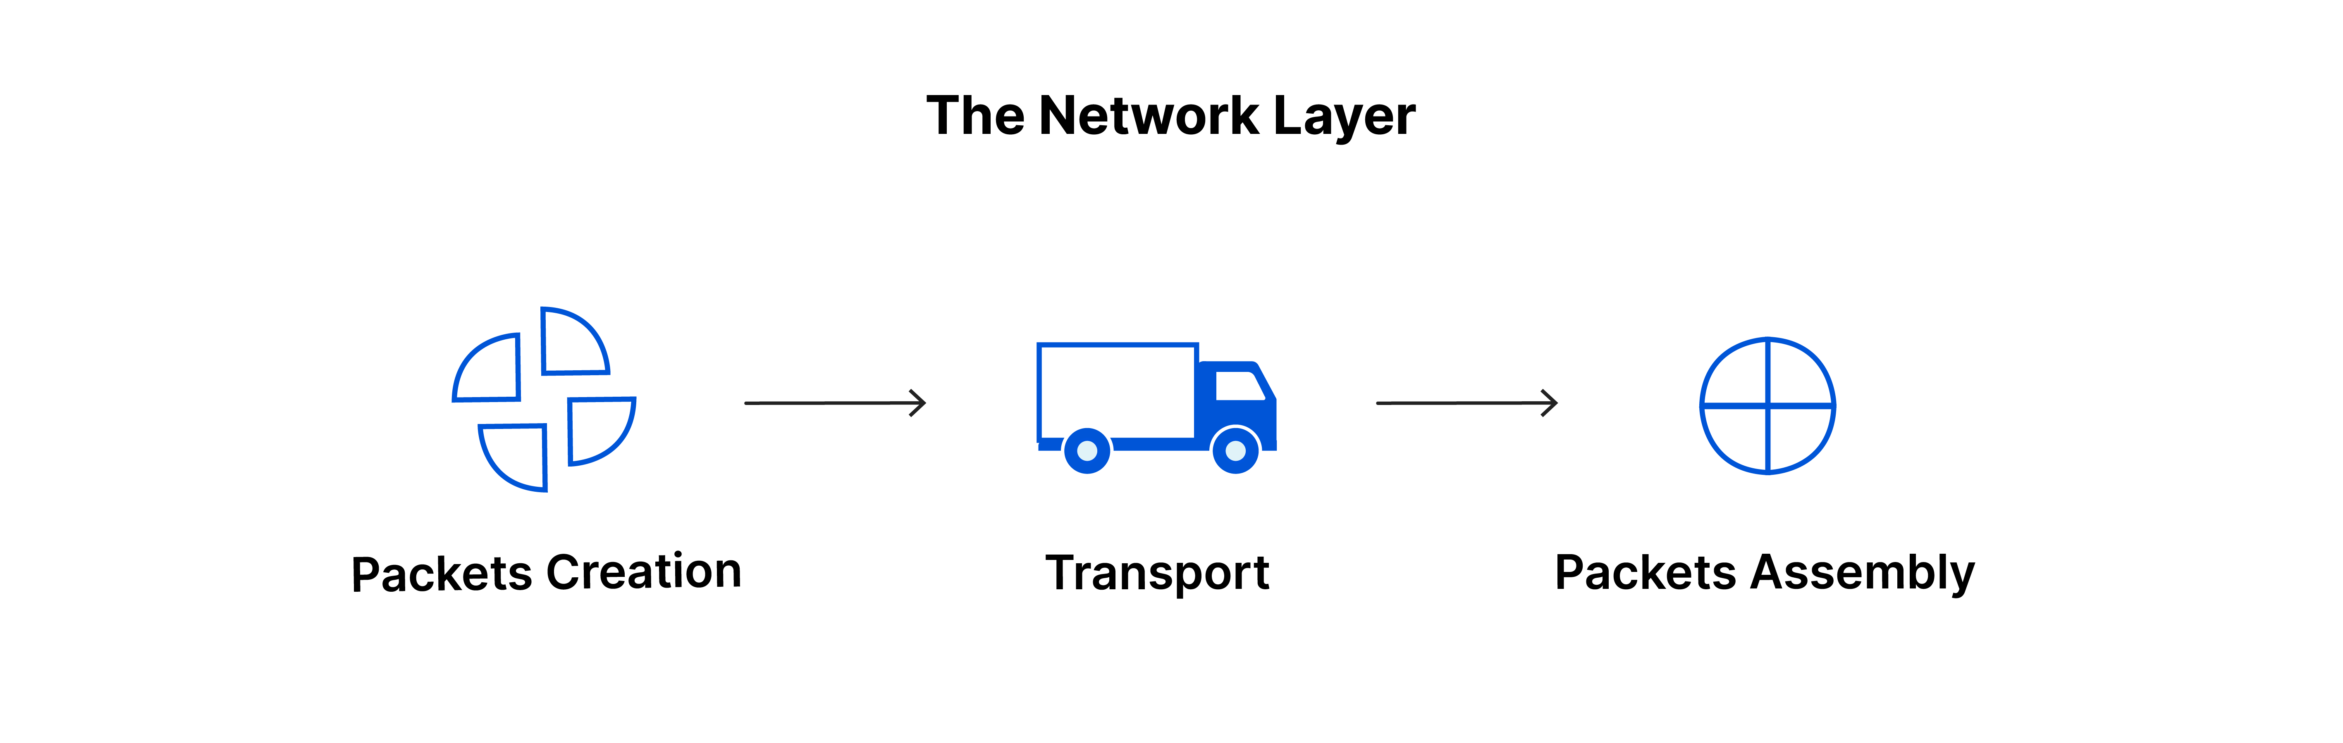
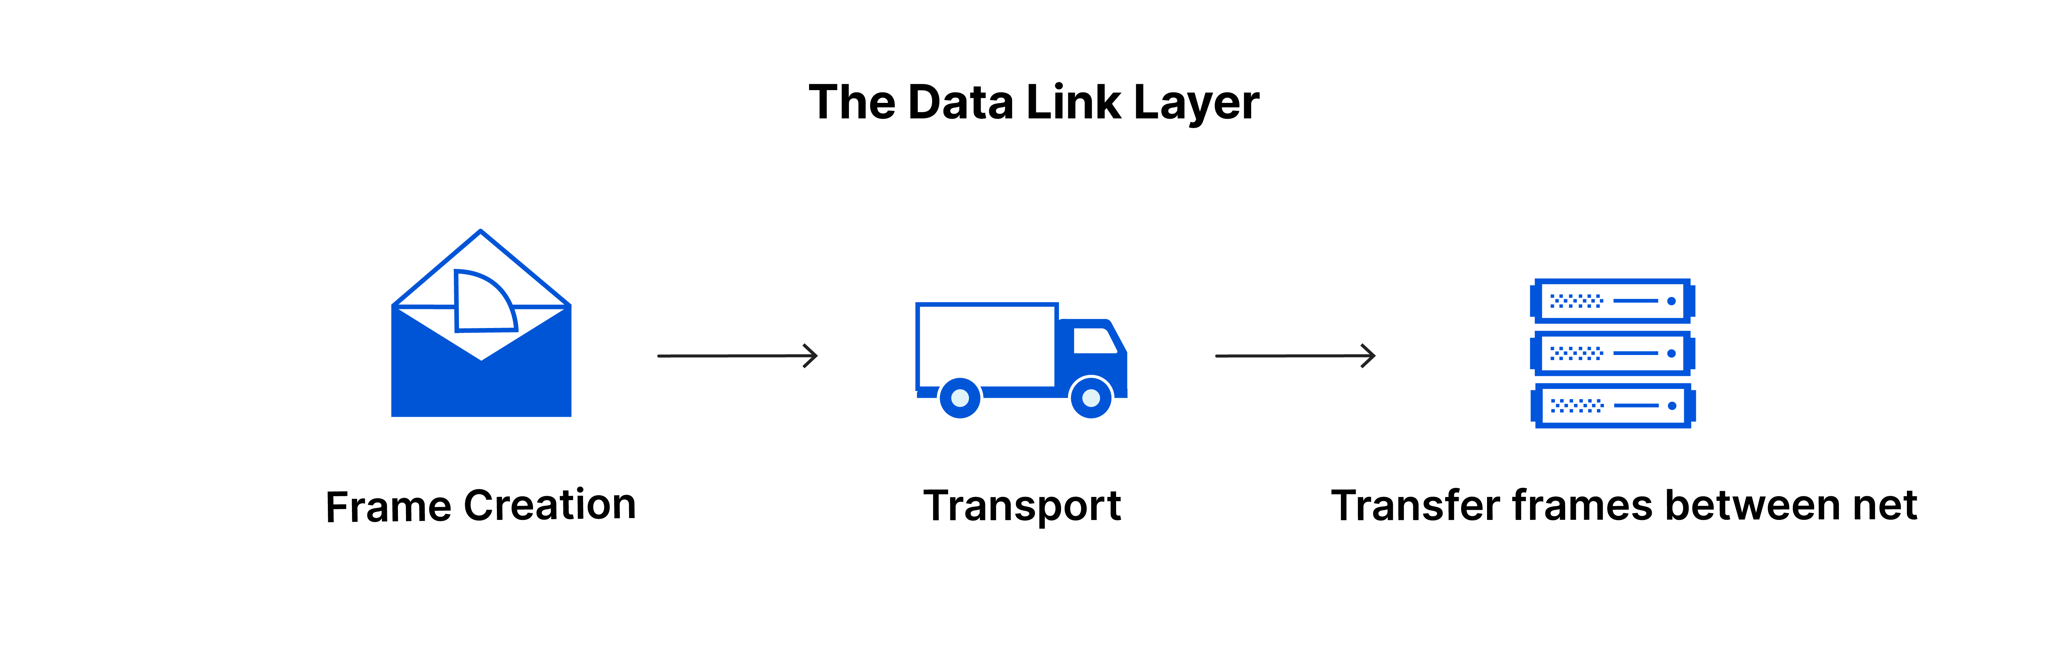
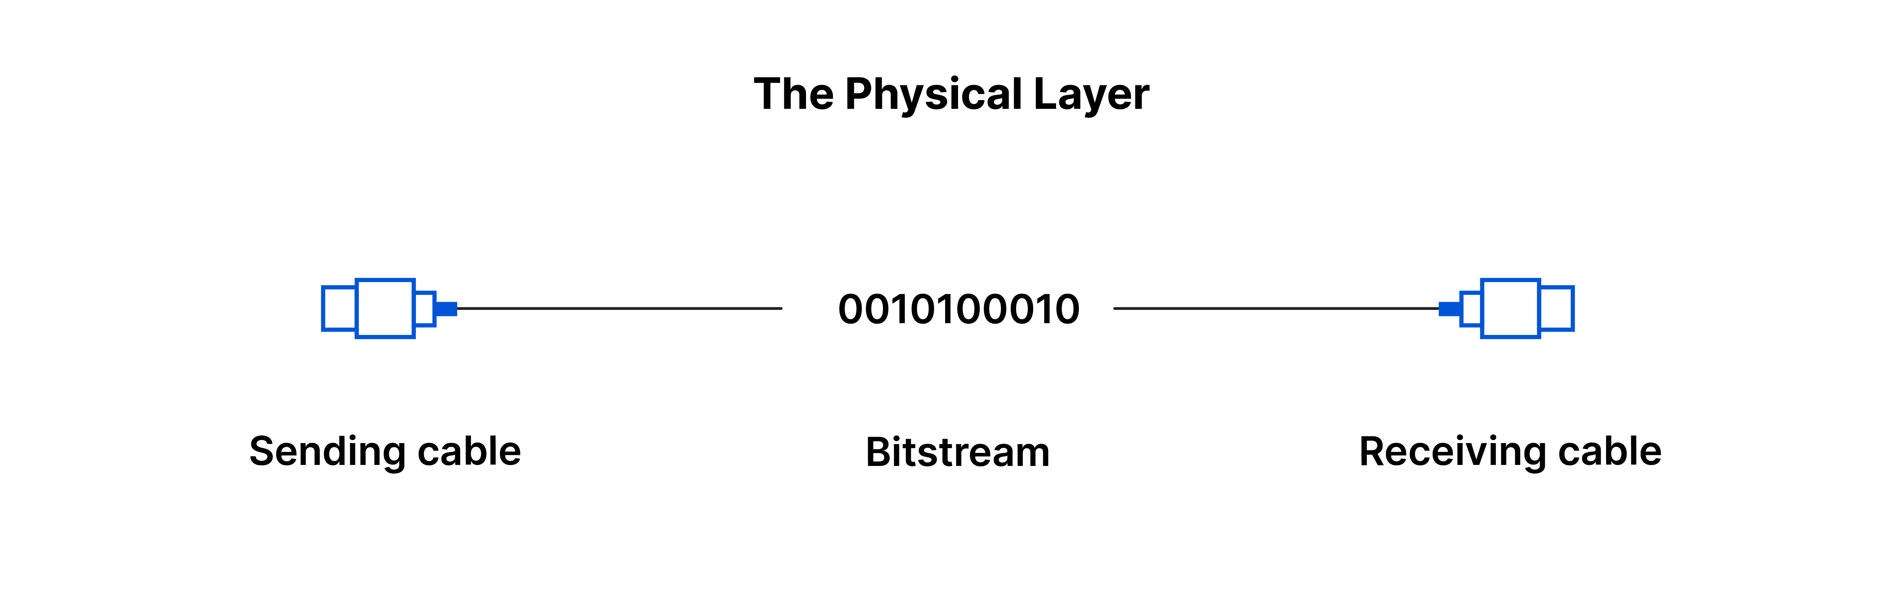
An Insultingly Shallow Intro to Networking
SERVER
(a program running on a computer in a data center somewhere)
CLIENT
(a web browser running in a consumer operating system on a consumer device)
https://www.cloudflare.com/learning/ddos/glossary/open-systems-interconnection-model-osi/
Notes:
There’s a whole enormous stack of technology used to connect the physics of electronic communication to the goal of streaming Severence on Apple TV. Again, there’s are multiple other courses on this.
BUT — sometimes software engineering does involve working in settings where you don’t have all the context, relying on abstractions, standards, and design patterns. It’s hard, but important, to learn how to judge whether you need to learn more, or whether you can ignore the details, or whether you need to find or hire an expert who knows more.

Slide 7
An Insultingly Shallow Intro to Networking
SERVER
(a program running on a computer in a data center somewhere)
CLIENT
(a web browser running in a consumer operating system on a consumer device)
Transport Layer
TCP you may have heard of
UDP you don’t need for this class
QUIC is new
Key abstraction: sending a message
https://www.cloudflare.com/learning/ddos/glossary/open-systems-interconnection-model-osi/
Notes:
What is worth understanding here is that there are more-or-less leaky abstractions at play.
One that’s worth mentioning is the “Transport layer” — if you’ve heard of TCP or UDP, that’s technology that exists at the transport layer.
For this class, “sending a single message” at the transport layer is a pretty stable abstraction to think about: it’s an arrow drawn from the client to the server, or the server to the client. Most of you will never have to think about how networks send a single message in the same way you’ll never need to understand how chips implement an instruction set architecture.

Slide 8
Application Layer Abstractions: RPC/REST
Remote procedure calls happen via HTTP requests (REST)
GET /
ok here you go (status 200, payload <!doctype html><html lang=“en…)
SERVER
(a program running on a computer in a data center somewhere)
CLIENT
(a web browser running in a consumer operating system on a consumer device)
GET /favicon.svg
ok here you go (status 200, payload <svg width="450" height="450" viewBox="…)
POST /api/user/login, payload {"username":"user1","password":”password"}
ok here you go (status 200, payload {"error":"Invalid username or password"})
Notes:
The top level is called the “application” layer, but it’s still a ways away from streaming Severance on Apple TV. HTTP is at the application layer. For the purposes of our discussion, it consists of pairs of request-and-response messages.
GET and POST requests that the simple Express webserver we’ve already seen fit this model exactly: the web server initiates a request, and the server communicates back one time. They involve two messages: one from the client to the server, and one from the server to the client.
IDEALLY, DEMO TIME — actually look at these in the network menu: go to google or GameNite, open the networking tab, and see how to get a cURL url, and then remove most of the headers (for GameNite, generally only the Content-Type: application/json header is actually important)

Slide 9
Application Layer Abstractions: RPC/REST in Express
How this looks for an Express server
SERVER
(a program running on a computer in a data center somewhere)
POST /api/user/login, payload {"username":"user1","password":”password"}
ok here you go (status 200, payload {"error":"Invalid username or password"})
CLIENT
import express from 'express’;
let numLogins = 0;
const app = express();
app.use(express.json());
app.post('/api/user/login', (request, response) => {
const { username, password } = request.body;
if (username.toLowerCase() === 'user1' && password === 'sekret') {
response.send({ success: true, numLogins: numLogins++ });
} else {
response.send({ error: 'Invalid username or password' });
}
});
Notes:
(This is just a review of what we’ve already seen, go quickly. Only thing to highlight is that app.post is taking as its first argument a route, and that route is where you send the post request.)

Slide 10
Application Layer Abstractions
Message Passing happen via WebSockets
I would like to join this chatroom ["chatJoin",{"auth":{"username":"rob",”pass…)
SERVER
(a program running on a computer in a data center somewhere)
CLIENT
(a web browser running in a consumer operating system on a consumer device)
i got u ["chatJoined",{"_id":"68112e17c5df6e25e2c0a2c7","messages":[{"_id":"68136f9ac5df…)
hey someone joined chat ["chatUserJoined",{"user":{"username":”tim”, “display”:”T…)
hey someone joined chat ["chatUserJoined",{"user":{"username":”bo”, “display”:”Ro…)
Notes:
Another important form of client server communication for this class is two-way websocket communication. This differs from remote procedure calls with REST because the server and client set up a persistent connection (the ”socket”) and either player can send a message to the other one. This is what you want for chat.

Slide 11
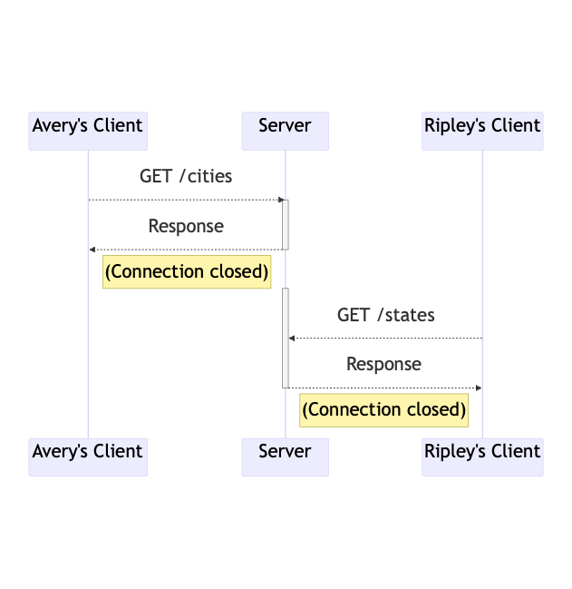
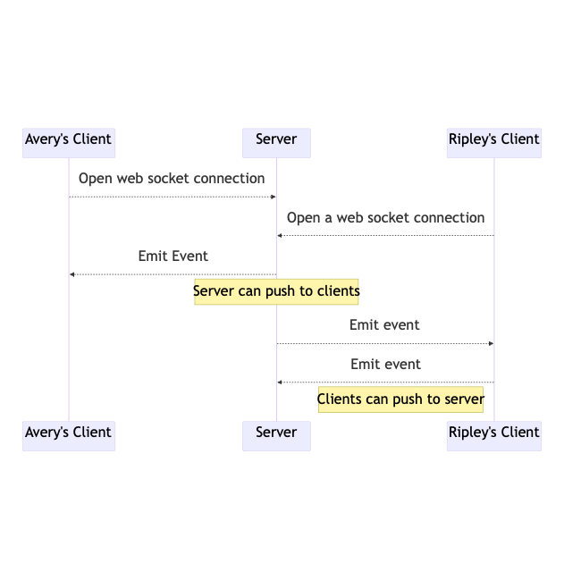
Application Layer Abstractions
REST
Web Sockets
Notes:
REST and WebSockets are the two most important client-server communication styles.
Q: Do you really need both?
(A: if you only have REST and you want real-time chat, you have to constant poll the server “hey, did anything happen?” which is generally slower and requires a lot of useless work. You *could* do almost everything with websockets, and that’s how some applications are built… but sometimes you just want to make a function call or get a new webpage, and single-request-single-response is the right model for that. REST applications are also, in general, easier to test.)
<edit this at: >
https://mermaid.ink/img/pako:eNqFkUFrAjEQhf_KEBBbUASPOQjFlp560R5zSZNZDWQn28xEEPG_N9tYaK20OU1mvnnz4J2USx6VVozvBcnhY7C7bHtDUN9kArZIotK_YW6twWYJLgyWBBxYhocD5uOUYR0DkvyGeIS2mCsGNySW43gThojXIg7m89UKWMPz0yssXJCA3EbWSThYQbj8uaFOwwZ5SMTY-h6vSUq1jtgJpG6UvlsnIqxQInAxMfp7Q7ePVKs_DLHUIX_RzYJb_m_hm5Ecdvs_nKiZ6jH3Nvga0GncM0r22KNRupYeO1uiGGXoXNExqe2RnNKSC85UGXy9eslT6c5Grl30QVJ-aaF_Zn_-AHpDpwY?type=png)](https://mermaid.live/edit#pako:eNqFkUFrAjEQhf_KEBBbUASPOQjFlp560R5zSZNZDWQn28xEEPG_N9tYaK20OU1mvnnz4J2USx6VVozvBcnhY7C7bHtDUN9kArZIotK_YW6twWYJLgyWBBxYhocD5uOUYR0DkvyGeIS2mCsGNySW43gThojXIg7m89UKWMPz0yssXJCA3EbWSThYQbj8uaFOwwZ5SMTY-h6vSUq1jtgJpG6UvlsnIqxQInAxMfp7Q7ePVKs_DLHUIX_RzYJb_m_hm5Ecdvs_nKiZ6jH3Nvga0GncM0r22KNRupYeO1uiGGXoXNExqe2RnNKSC85UGXy9eslT6c5Grl30QVJ-aaF_Zn_-AHpDpwY

Slide 12
Building Real Client-Server Applications
The Express servers we’ve seen in this class (including the IP1 code) aren’t great
What user needs aren’t they meeting?
How can we do better?
(A user doesn’t want their messages to disappear)
(Add a database)
Notes:
A server is a computer that multiple clients are connecting to, and the clients can communicate with each other through their connections to the server (chatting, writing posts, or playing games on GameNite).
Most of the servers we’ve seen so far haven’t been very good. What makes them not-so-good and how do we build better ones?

Slide 13
Building Real Client-Server Apps
numLogins resets whenever you stop running the program
import express from 'express’;
import { z } from 'zod’;
type UserAuth = z.infer<typeof zUserAuth>;
const zUserAuth = z.object({
username: z.string(),
password: z.string(),
}); let numLogins = 0; const app = express();
app.use(express.json());
app.post('/api/user/login', (request, response) => {
const { username, password }: UserAuth = zUserAuth.parse(request.body);
if (username.toLowerCase() === 'user1' && password === 'sekret') {
response.send({ success: true, numLogins: numLogins++});
} else {
response.send({ error: 'Invalid username or password' });
}
});
there’s one user and one password and it’s hard-coded
Notes:
The Express servers we’ve seen so far in lecture are kind of silly: you can’t build a real application like this.
(click)
At least wo reasons:
- Well, sometimes you need to stop your webserver, so just tracking numLogins in memory is a bad idea, because it resets when you reset the server.
- It’s also obviously a bad idea, most of the time, to have your username and password baked into your application’s code.
The IP1 application is silly in the exact same way: was people annoyed by the fact that the games reset completely whenever you edited the server code?
In a real application, these are going to exist in a database.

Slide 14
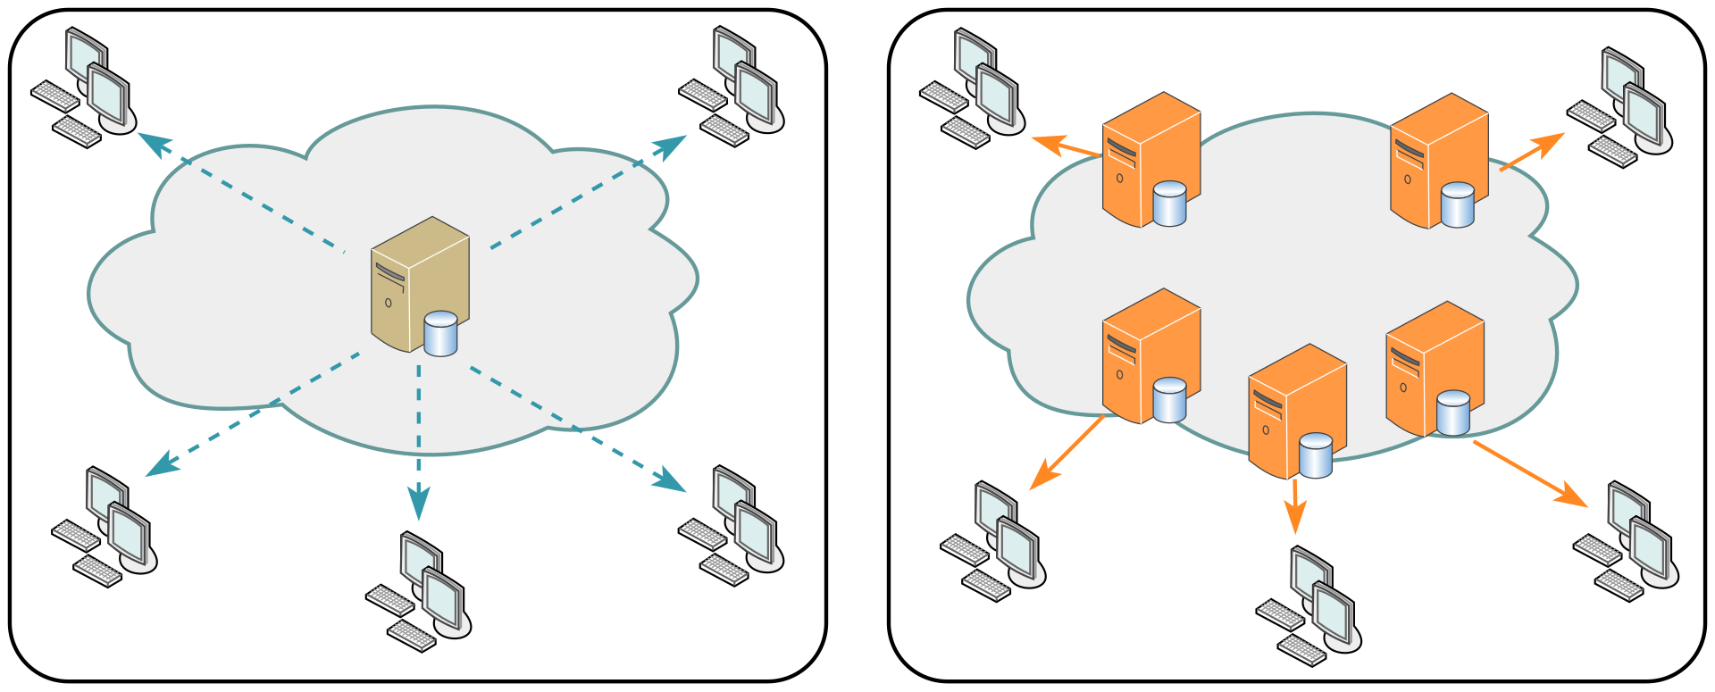
State and statelessness
Web applications have state: they’re ultimately storing or modifying something
Otherwise, maybe don’t have a server running Node at all?
Content Delivery Networks have put tons of work into solving that distributed systems problem.
Static sites are fast & cheap
https://en.wikipedia.org/wiki/Content_delivery_network
Notes:
What are exceptions to the fact that web applications have state?
(Something like ezgif that converts mov files to gif and things like this doesn’t really need a persistent database behind it. Live.lean-lang.org is another example: when you connect to the website you get only a very temporary Lean session you can interact with; reload to refresh the session. Common denominator: these are websites that are giving access to some program or computational resource you don’t have on your phone or laptop. Unless you’re just providing people access to a resource, most of the the time you do want some database-driven state. Otherwise, you don’t need a server at all, you should consider building a local-first web application: https://alexop.dev/posts/what-is-local-first-web-development/)

Slide 15
State and statelessness
A web server or web service should be stateless
Every REST request should be indifferent to whether the node application has been running for several hours or five seconds
Our silly application, and the IP1 code, is not stateless (why?)
If the web server is going to be stateless, and the web application has state, the server has to phone a friend to:
Access the filesystem
Query a database
Initiate some other remote procedure call to another server
Common case: a database is the point of centralization
Centralization (& hierarchical centralization) is a cheat code for making distributed systems managable

Slide 16
Three parts of a web server
The repository is the only part that stores state
This is pretty much a synonym for “database”
The service doesn’t know how we connect to the client
HTTP? REST? WebSockets? The service shouldn’t know!
The controller doesn’t know how we store data
Are we actually “stateless,” or storing things in memory like IP1?
MongoDB? PostgresQL? SQLite? A file on the hard drive?
Repository
API
Service
API
Controller
internet
Client
browser
User
Notes:
Talk about the CSR architecture.

Slide 17
CSR Architecture
import {
StudentID,
Student,
Course,
CourseGrade,
Transcript,
} from './types.ts';
export interface StudentService {
addStudent(studentName: string): Student;
getTranscript(id: Student): Transcript;
deleteStudent(id: Student): void;
addGrade(id: Student, course: string, courseGrade: CourseGrade): void;
getGrade(id: Student, course: string): CourseGrade;
populateNames (studentName: string): Student[];
}
Notes:
Remember this? What kind of thing is this in the CSR architecture? (The service!)
What’s the critera for a service (doesn’t know how we connect to the client)
Does this meet that critera (yes!)

Slide 18
CSR Architecture: Service interface
Everything we saw from the transcript server is the business logic — the most boring name possible for “the interesting stuff that a web server does that isn’t just reading from a database”
“Is this person an authenticated user?” — usually not business logic
“Does this user have permission to access student records” — business logic!
“Do new grades go at the front or back of the list” — business logic!
Notes:
Connections:
in module 2 we talked about testing for a service layer abstraction
in module 3 and earlier in this lecture we saw how Express implements a the controller part of the abstraction
IP1 has a service and controller layer… but no real repository, it’s just using hashtables in memory to store all its data
IP2 and beyond will have all three layers: controller, service, and repository

Slide 19
Testing
We can test at both the service layer and the controller layer
What are the pros and cons of each?
Sometimes we’ll want to test the service layer and/or controller layer without the repository layer!
We’ll come back to this.
Notes:
(Note: you need mocking to test the service layer without the repository layer, which hasn’t been covered yet)

Slide 20
Web Applications and Scalaibility
Distributed systems are hard!
Web applications are designed to only be kinda difficult-to-build distributed systems
Most of this lecture is bad advice if you’re Google, Netflix, or Amazon
Web applications are distributed systems because
You don’t live in the cloud
Scalability: Netflix needs at least two computers
Notes:
So far in this lecture, we’ve talked about why we need web applications to be distributed systems from the perspective of allowing people in different locations to communicate. The rest of this lecture is about scalability.

Slide 21
Scaling & the database bottleneck
Web services often start on a single computer
Stateless web servers make it possible to horizontally scale your web service as you get more users: add more cheap stateless web servers!
AWS will be delighted to help, only real limit is money
Centralized databases tend towards vertical scaling: move your database to a more powerful computer
This has limits

Slide 22
Scaling & the database bottleneck
Most applications want to do expensive but periodic data analysis on the database
Database read-only-replicas are an easy solution here — seconds to minutes behind reality (and can add reliability in case of failure!)

Slide 23
Scaling & the database bottleneck
If you’ve got a bunch of data (or computation) that can handled separately and independently, you can put that somewhere else and have two independent databases
Chat and game information could be in separate places
Games could have their business logic running on different servers, written in different programming languages, and accessed (by the server the client is connected to) through their own REST API!
This way lies microservices

Slide 24
Microservices
Different languages, different operating systems
NodeJS, MongoDB
Google Service
Java, MySQL
Todos
Logins
Mailer
Mod 1
Mod 2
Mod 3
REST service
REST service
REST service
Productivity App
Database
Database
Database
Frontend
REST
Search Engine
Analytics
Social Crawler
“Dumb”
App Server
Mod 4
Mod 5
Mod 6
REST service
REST service
REST service
Database
Database
Database
Java, Neo4J
C#, SQLServer
Python, MongoDB
Notes:
Here is an example of a micro services architecture for a productivity application. There are multiple components to this application. Each component is shown as a grey box, and is a micro service.
(Note the separation of responsibilities to entirely different services that only connect over a well-defined API)

Slide 25
Microservices
Netflix is the microservices darling
100s of microservices
1000s of daily production changes
10,000s of instances
BUT:
only 10s of operations engineers
https://medium.com/refraction-tech-everything/how-netflix-works-the-hugely-simplified-complex-stuff-that-happens-every-time-you-hit-play-3a40c9be254b

Slide 26
Microservices
The opposite of “microservices” is “monolith”
higher is better
https://martinfowler.com/microservices/
Notes:
Microservice advocates claim that as the system grows in complexity, the micro service abstraction provides gains in understanding and productivity that outweigh the cost of the added complexity.
It would be interesting to have some hard data about this, but companies probably don’t want to be too transparent about stuff like this.

Slide 27
GameNite is Monolithic
GameNite is a monolithic application
It’s not perfect: there’s probably a bit too much business logic in the controller layer (service layer doesn’t quite do enough)
You’ll start IP2 with a proper repository
MongoDB is the database used for repository layer, using a library called KeyV
The controller doesn’t have to change (much) to support this

Slide 28
Foreshadowing
Moving GameNite to a real repository requires one big change in the server!
almost every action that reads or writes data is now hundreds of times slower, and involves reading to disk
this involves a relatively long delay, during which the CPU isn’t doing anything useful
JavaScript handles this with asynchronous programming; that’s a topic we’ll return to in a few weeks.

Slide 29
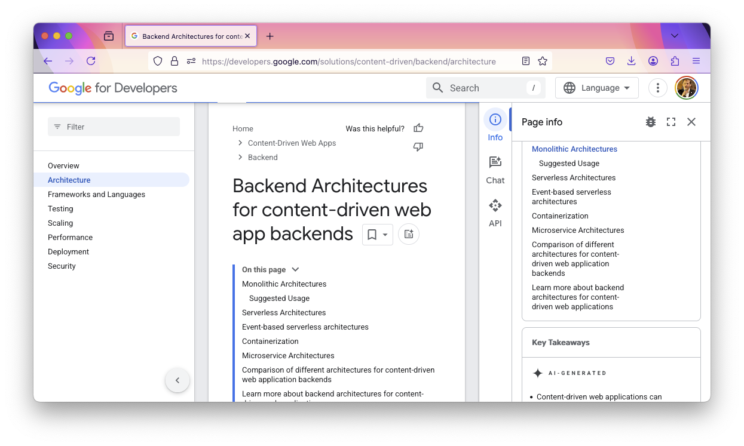
Review
Notes:
We’ve talked about web applications and how web application backends are built. Hopefully there are a lot of key terms on this page that you can explain that you couldn’t before? (Maybe if time, ask if questions about any other jargon?)

Slide 30
Review
It’s the end of the lesson, so you should be able to
Explain the role of “client” and “server” in the context of web application programming
Explain the role of REST versus WebSocket communication
Describe the fundamental differences between the three layers of the controller, service, and repository layers in a C-S-R architecture
Be able to answer an interview question about “business logic,” “horizontal and vertical scaling,” or “microservices”

